Slide 1
How (the simplest) ODE solvers work
Set an initial condition
Work out the gradient (dV/dt)
Take a step in time at that gradient
Repeat until you reach end time
Voltage
Time

Slide 2
What you need to know about numerical solution of differential equations
Two main types of Ordinary Differential Equation solvers
1. Fixed time step
set time step to determine accuracy
2. Adaptive time step
set desired accuracy and solver adapts time step to meet it
In both cases, you should always check you have a ‘converged’ solution – reducing the time step, or increasing accuracy, gives you the same answer, to within a small tolerance.

Slide 3
What can go wrong – fixed time steps
With fixed time steps, the gradient can change too fast for the solver to capture.
Solution: smaller time steps.
Probability
1
Negative probabilities and undefined bad behaviour from here!
True solution
0
??
Time

Slide 4
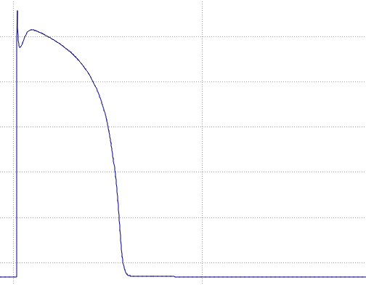
What can go wrong – adaptive solvers
Solver puts in lots of steps when things are changing, not many when things are flat – ideal? Usually…
Voltage
Time

Slide 5
What can go wrong – adaptive solvers
Adaptive solver can miss a stimulus current application!
Solution:
stop and re-start solver at stimulus time OR
define a maximum time step same length as stimulus current.
Voltage
Time

